Slide 1
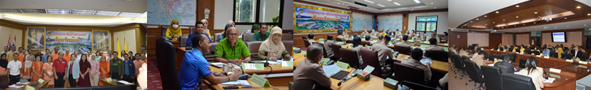

A Multidisciplinary Studies in Environmental Issues for Planning and Management
Dr. Saudee Maprasit
Faculty of Science Technology and Agriculture
Yala Rajabhat University

Slide 2
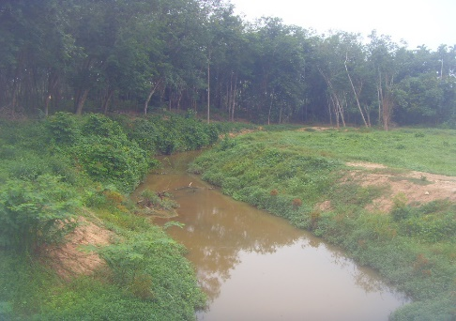
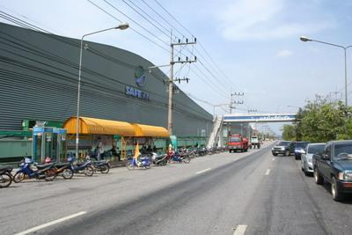
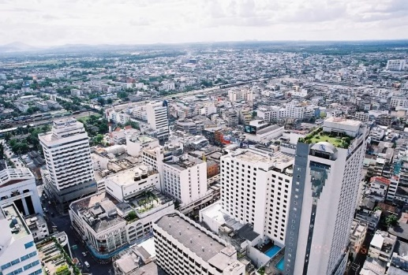
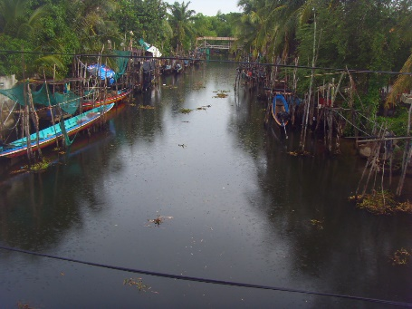
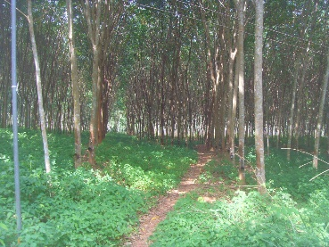
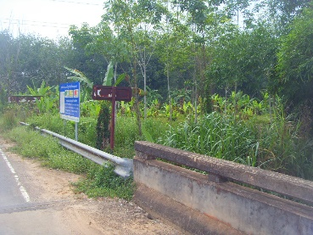
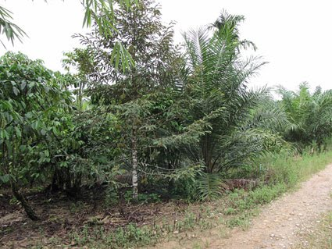
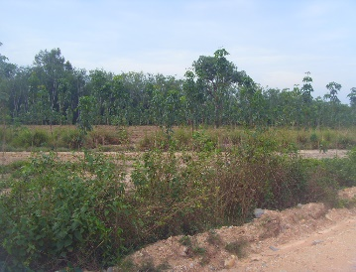
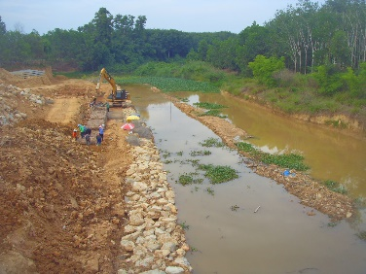

Slide 3
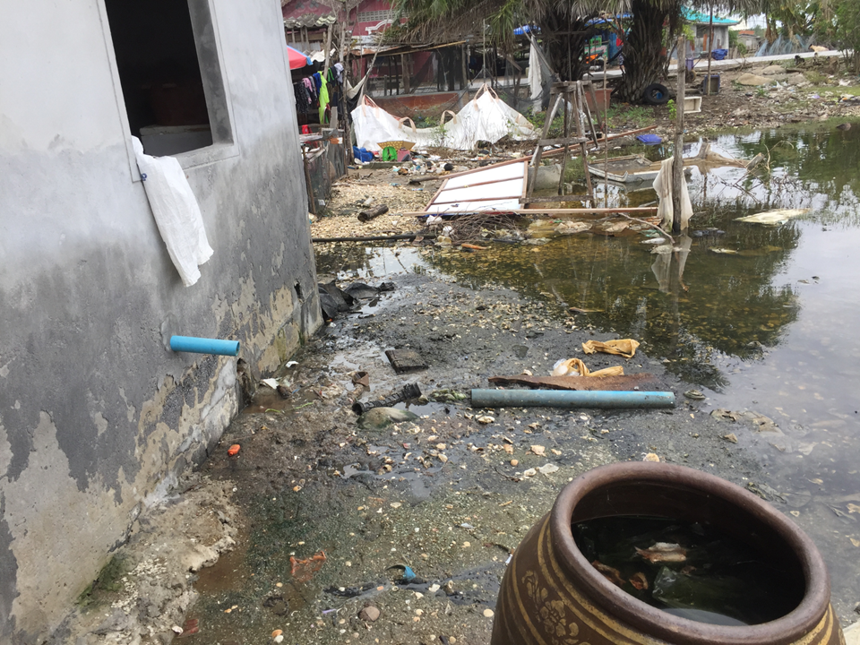
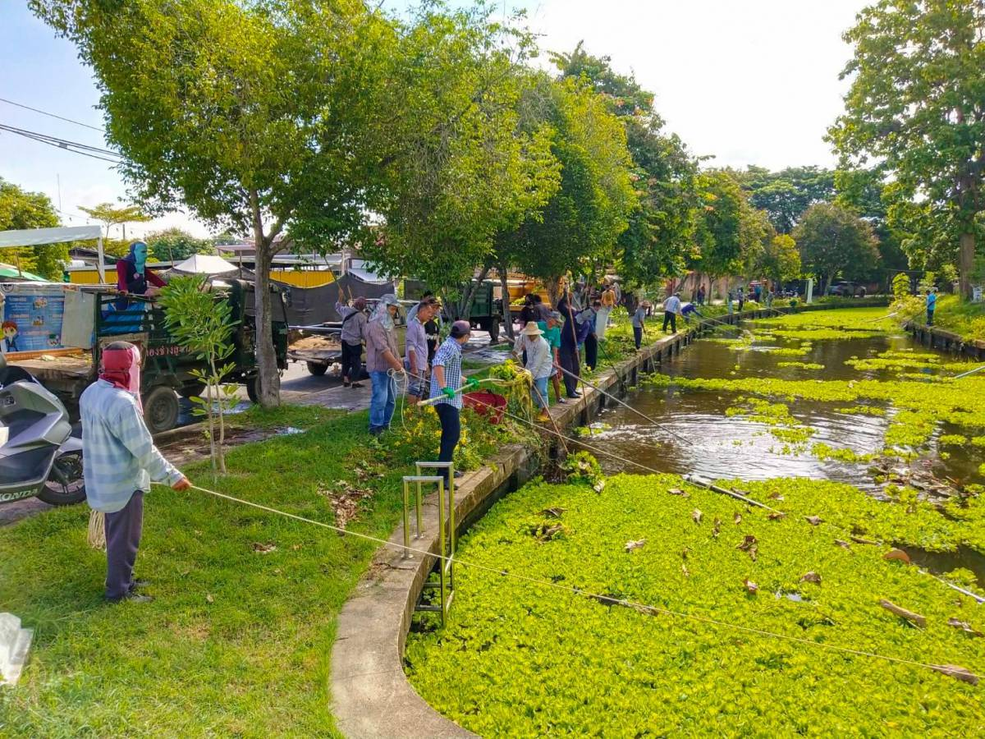
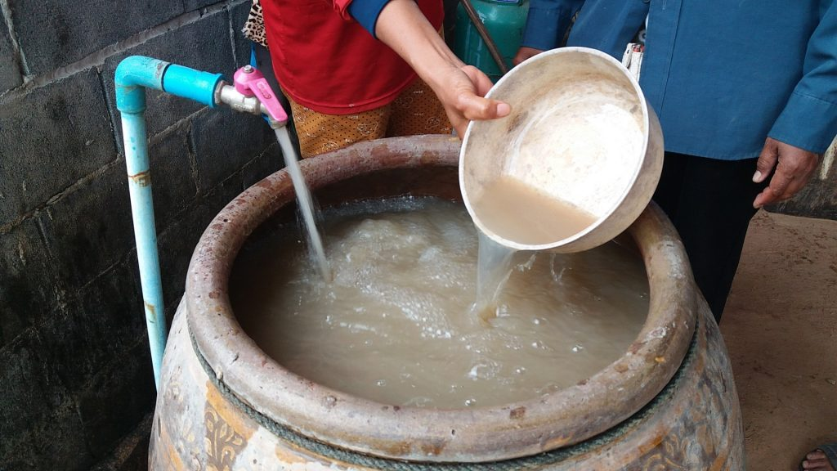
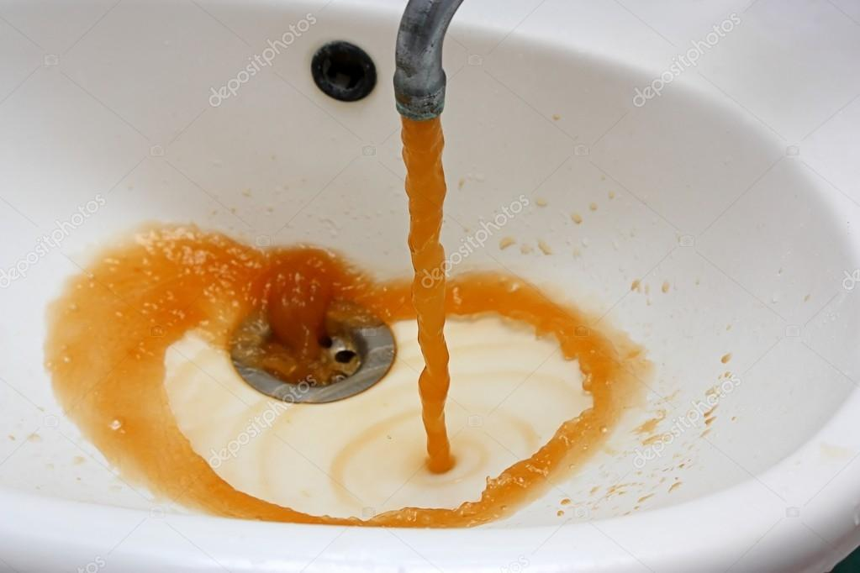
Land use
Water quantity and quality
Trends of degrading water
Land use management (domestic, local enterprise and agriculture)
Influence Factors to WQ and WQM
Water issues

Slide 4
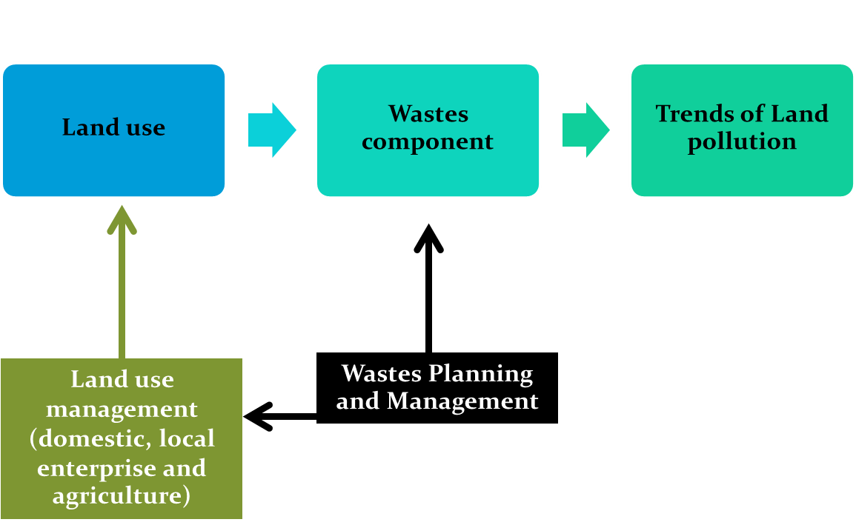
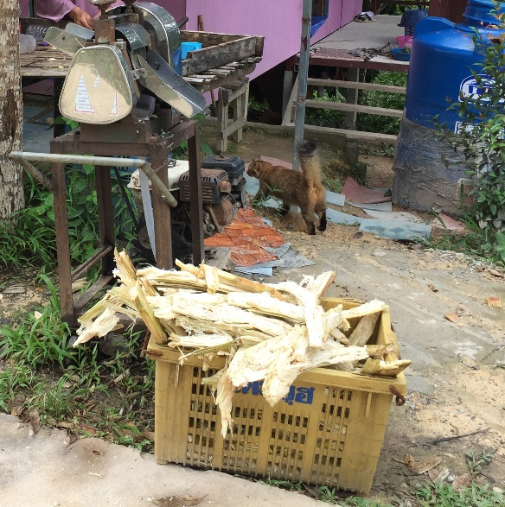
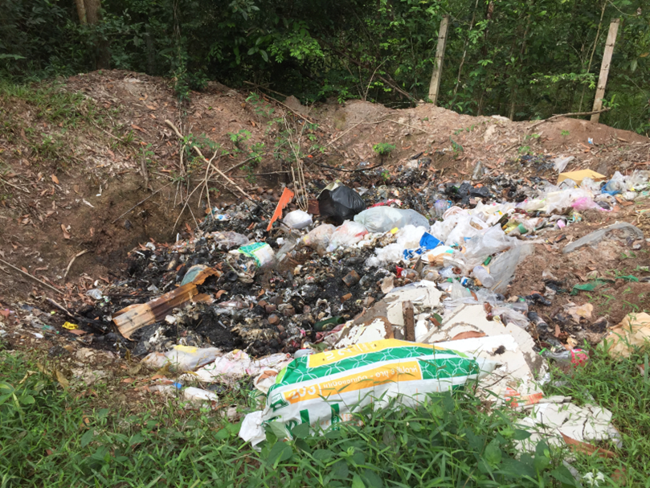
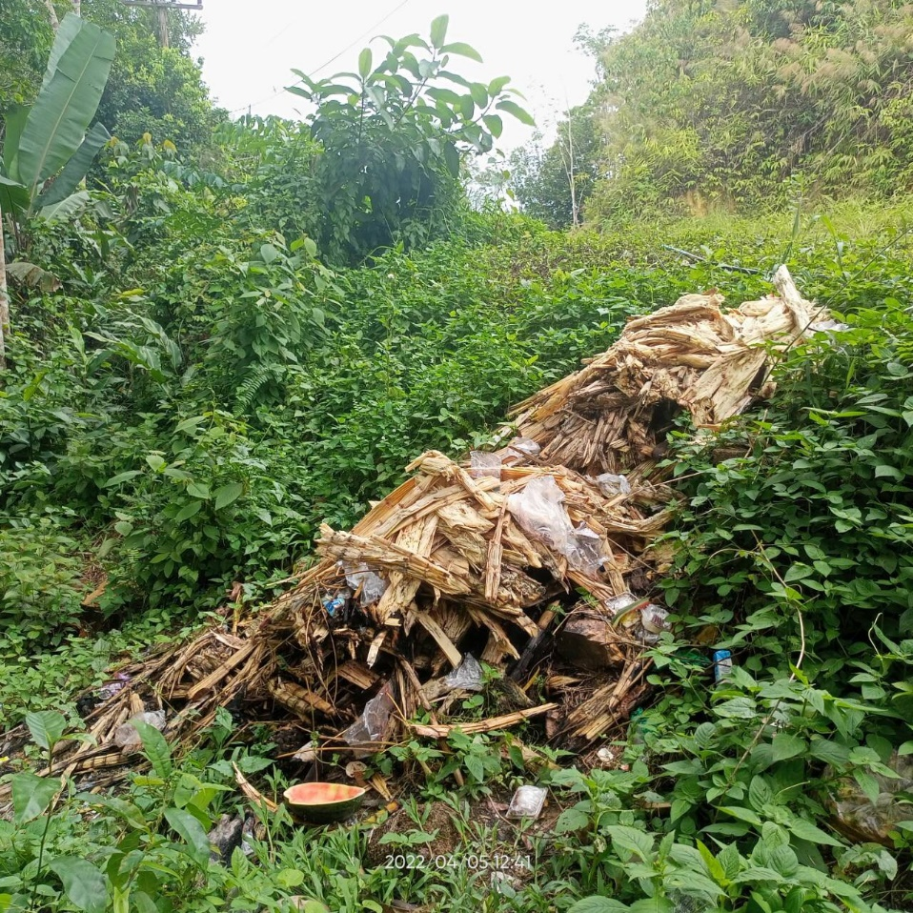
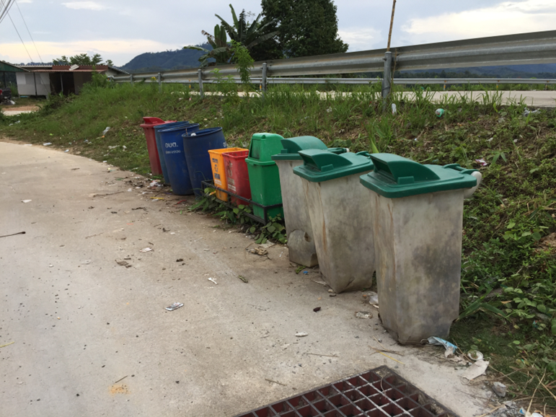
Wastes issues

Slide 5
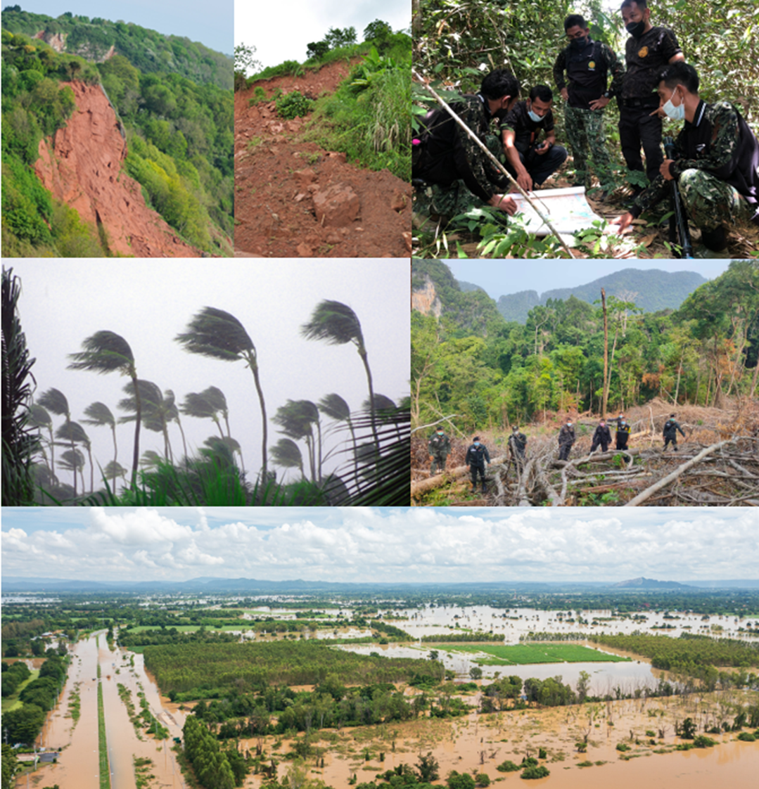
Agricultural area
Forest area
Trends of Land slide and Floods
Land use management (agriculture)
Agricultural Land use Planning and Management
Natural Resources and impact issues

Slide 6
So, environmental studies for problem solving are complex system education that focused on related factors based on temporal-spatial change. Environmental issues in planning and management have to study behavior and trends of dynamic change include relationship and interaction of variables in the system under different of spatial and temporal.

Slide 7
Multidisciplinary studies in water management
To study interrelationship of water quality parameter with land use pattern and practice based on hydrologic and climatic variation.

Slide 8
Introduction
Water is one of the most essential constituents of the human environment.
Water quality refers to the physical, chemical and biological characteristics.
Increasing world population has resulted in higher food and energy demand and consumption over the past half century
Water quality degradation associated with nitrate leaching from agricultural soils is an important environmental issue worldwide

Slide 9
Introduction: Research Objectives
Minor objective
To study relationship of climate, hydrology, water quality and land use variables.
To quantify the contributions impact of land use pattern-practice on water quality in the river systems based on hydrologic and climatic change comprehensive the single-factor and integrated assessment.
To make predictions in probability of water quality occurrence by stochastic simulation model based on the proposed modeling methods under different scenarios.
To discuss the principles of possible management for how to solve the problem of land use pattern and practice impacts on water quality and what feasible actions should be taken from causing adverse effects of hydrologic and climatic change.

Slide 10
Significance of Water quality variations
organization | contents
USDA 2003 | The main component influence to water quality degradation is products from point-nonpoint source.
UNESCO 2005 | The execution contains various components and uncertainty of qualitative and quantitative information from the interrelationship in theirs.
UNICEF/WHO 2008 | The obstacle of water quality management is large scale and plenty of factors. Water quality management should base on system.
UNEP/GEO5 2012 | Effect of extreme water related events and climate change
UNEP 1992,1996,2015 | The natural events may be related from human activities and could be harmful to water quality.

Slide 11
Water quality study and management
Issue | summarized | Author’s remark
Water quality | To assessment surface water quality, point/non-point source pollutants and management wastewater discharge. | How water quality by physical, chemical and biological characteristics has interrelationship system (capacity water resources).
Climate | To study relationship of air temperature on water quality. | Temperature can impact on water quality by maximum value or average value (water quality value and balance)
Hydrology | Hydrologic parameters comprehensive spatial and temporal variable | How spatial hydrologic; intercept, cross-section, slope and pattern of drainage sub-river impact on water quantity-quality. How temporal hydrologic; water level, water flow, in-out flow can impact by positive or negative to water quantity-quality (water quality balance).

Slide 12
Water quality study and management
Issue | summarized | Author’s remark
Land use | Comprehensive land use type such as urbanization, agriculturalization, industrialization | Described in pattern of land use/land cover for example; there are relation of surface water quality with agriculture in term of livestock (such as pig farm, cow farm), fishery and plantation (such as rubber, orchard) and how land use pattern and practices impact on water quantity-quality (point/non-point sources pollution).
Methodology | Statistical technique and Combined statistical technique with statistics and model software | Combined statistical technique with model software
Social factors | There is budget (cost) in waste water treatment and population growth in scenario of urbanization. | It should be study in term of relative to water quality management with public policy, public participate, society network and population in surface water management (water quality management).

Slide 13
Methodological framework
methodology | contents | tools | output | outcome
1.correlation analysis | Find and reach the main factor and direction of components in water quality system | Statistics analysis by using SPSS | The relationship system of water quality | Considered and selected variables in water quality management
2. regression analysis | Find the significance factors in water quality degradation and prediction value |  | Directional water quality variation | Directional planning and management
3. water quality simulation | Water quality forecast by time-period change (temporal) | System dynamics (vensim v5.0) | Water quality trends | Directional and scenarios planning and management
4.discussion | Implication for water quality management | Literature review | Administration in water quality management | Reduce water quality degradation

Slide 15
Climatic variations (CV) | Mean Maximum Climatic Temperature | Celsius; ⁰C | MMX CT
 | Minimum Climatic Temperature | Celsius; ⁰C | MMN CT
 | Mean Climatic Temperature | Celsius; ⁰C | MCT
 | Maximum Climatic Relative Humidity | Percentage; % | MMX CRH
 | Minimum Climatic Relative Humidity | Percentage; % | MMN CRH
 | Mean Climatic Relative Humidity | Percentage; % | MCRH
 | Wind Velocity | knot (1.852 km/h) | WV
Factors | Variables | Unit | Acronym
Water Quality (WQ) | Stream Temperature | Celsius; ⁰C | ST
 | Potential of Hydrogen Ion | Non | pH
 | Turbidity | Nephelometric Turbidity Unit; NTU | Tbt
 | Electrical Conductivity | µs / cm | EC
 | Dissolved Oxygen | mg / L | DO
 | Biochemical Oxygen Demand | mg / L | BOD
 | Total Coliform Bacteria | MPN/100mL | TCB
 | Fecal Coliform Bacteria | MPN/100mL | FCB
 | Ammonium Nitrogen | mg / L | NH₃-N
Land-Use practices (LUPR) | Urbanized Population | People | UP
 | Urbanized Population Density | People / area; pp/km² | UPD
 | Agricultural Area | Square Meter; m² | AA
 | Agricultural Buffer Area | Square Meter; m² | ABA
 | Industrial Wastewater Discharge | Cubic meter; m³ | IWD
 | Industrial Distance to Stream | Meter; m | IDS
* Land-Use patterns (LUPA) | Urbanization | Non | UZ
 | Agriculture | Non | AC
 | Industry | Non | IT
Hydrologic variation (HV) | Rainfall | Millimeter; mm | RF
 | Flow In | Cubic meter; m³ | FI
 | Flow out | Cubic meter; m³ | FO
 | Stream Level | Meter; m | SL
 | Stream Width | Meter; m | SW
 | Stream Depth | Meter; m | SD
 | Stream Cross-Section | Square Meter; m² | SCS
 | Stream Velocity | Meter per second; m/s | SV

Slide 16
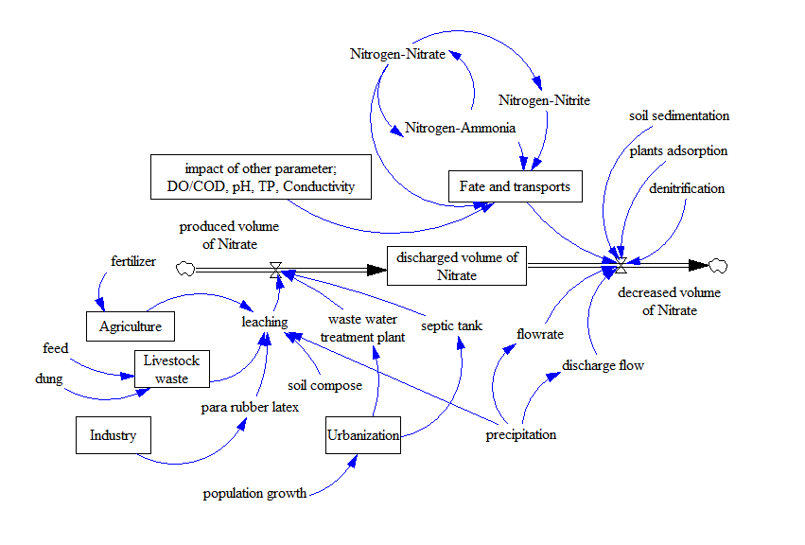
Nitrogen fate and transport

Slide 17
Components in Nitrogen assessment Modeling
Factors | Data | Unit |  | Description
Human activity
-agriculture | fertilizer | kg/day |  | Para rubber and corn plantation
-industry | rubber latex waste | kg/day |  | Para rubber latex industry
-urbanization | Nitrogen leaching from Waste water treatment plant | mg/L, ppm |  | 2 plant of Yala municipality
-population growth | population density | inhabits/m² |  | Permanent and transient population
-livestock waste | livestock waste | kg/day, L/day |  | Solid and liquid waste from stray animal; cow and goat
Hydrology
-precipitation | rainfall | mm/day |  | In the area of Yala municipality and Pattani Dam
-flow rate | flow rate of river | mL/s |  | Pattani river
-discharge flow | The amount of water flowing from mouth canal | L/s |  | Every mouth of canal in the area
Water-quality parameter in river
-Nitrogen-Nitrate | Nitrogen-Nitrate, TKN |  | mg/L, ppm | -UNEP/WHO 1996 -HACH DR/2010 spectrophotometer
-Ammonia | Ammonia |  | mg/L, ppm
-Nitrite | Nitrite |  | mg/L, ppm
-pH | pH-meter |  | none
-DO/COD | DO/COD |  | mg/L, ppm
-Conductivity and others. | Conductivity and others. |  | μs/cm

Slide 18
The relationship of climatic-hydrologic water quality
Water flow had positive correlation with TB, DO and NH₃-N and negative with TEMP and CD.
Water flow is a driver for turbidity increase and soluble matter decrease. The increase of water flow can flushed erosive soils and nutrients from land surface and increase sediments in river.
In other words it can decrease conductivity by carried soluble matters along the river.

Slide 19
CONCLUSION
There were significant correlations between climatic-hydrologic factors with water quality in river basin.
Climate temperature, precipitation, water level, water flow and cross-section are main drivers to impact water quality. Water temperature and NH₃-N are as sensitive for monitoring impact from climate and turbidity as for hydrology.
Therefore, water quality management planning should be consideration climatic-hydrologic change for developing improved in protection and control wastewater discharge from various land use.

Slide 20
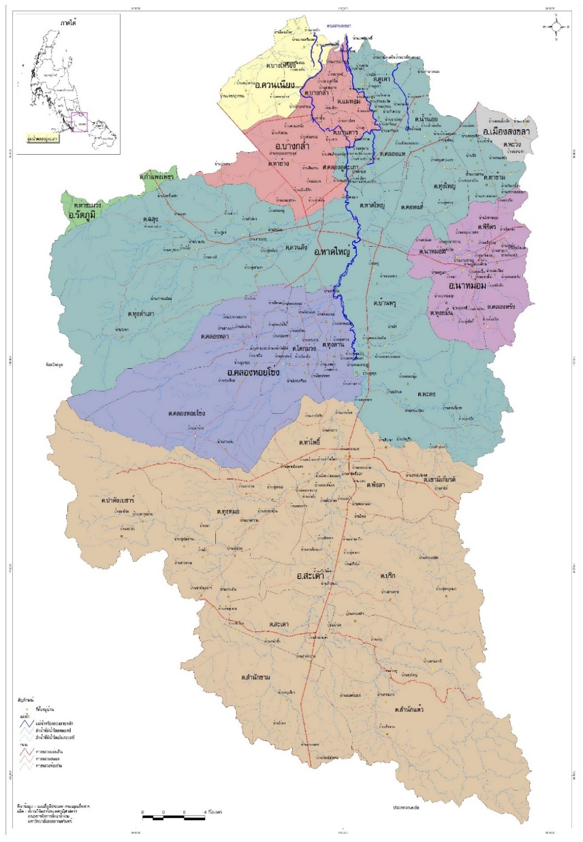
Clustered water quality variations: pollution sources
Pollution source by site station | Site station of pollution sources in each basin zone
 | Low | moderate | high
Downstream | 19 | 18,20,21 | -
Midstream | 12, 15 | 13,16,17 | 14
Upstream | 5, 7 | 3, 6, 9 | 8,4

Slide 21
Factor analysis of WQ variation
Variables | Non-rotated Component matrix |  |  |  | Rotated Component matrix
 | 1 | 2 | 3 | 4 | 1 | 2 | 3 | 4
TCB | .944 |  |  |  | .962
FCB | .927 |  |  | .242 | .970
WT |  | .738 | .219 |  |  | .729
pH |  | .630 |  | -.328 |  | .707
NH3-N |  |  | -.721 | .373 |  | -.569 | .416
DO | -.294 | -.341 | .589 | .247 |  |  | -.766
BOD | .201 | .274 | -.485 | -.310 |  |  | .657
CD |  | .406 | .221 | .543 |  | .208 | -.281 | .646
TB | .358 | -.460 | .249 | -.489 |  |  |  | -.771
Eigenvalue |  |  |  |  | 1.961 | 1.417 | 1.342 | 1.217
% of variance |  |  |  |  | 21.789 | 15.742 | 14.916 | 14.120
Cumulative % |  |  |  |  | 21.789 | 37.530 | 52.446 | 66.566
Factor 1
Factor 2
Factor 3
Factor 4
Conditions: KMO test (0.516) and Barlett’s sphericity test (586.901, df105,p< 0.001)

Slide 22
Factor analysis of WQ variation: description
Factor | Interpreted as | description
1 | Bacterial pollutants | TCB and FCB influenced by point sources such as urbanization with surrounding urban rim and human made area such planted forest, agro-pastoral land and barren land
2 | Nutrient pollutions and transform | WT, pH and NH3-N It presented natural factors impacted by seasonal change. The inverse relationship between temperature and nitrogen forms is natural process of nitrogen cycle because warmer water is cause of nitrogen transformation by biological process. Almost of this pollutant could be cause by non-point sources such as agricultural runoff and or domestic sewage discharge directly into river basin without treatment.
3 | Organic pollutants | DO and BOD This factor represented as “organic pollutants” which influenced by point source such as municipal and industrial effluents resulting from rapid urbanization as well as economical area.
4 | Solid pollutants | CD and TB explained by influenced pollution originating from industrial sewage and soil erosion.

Slide 23
Pollution sources identification
Basin zone | Site | factor | Season
Upstream | UT05, 07 | 4 (EC and TB) | Rainy
Midstream | UT12, 15 | 3 (DO and BOD) | Rainy
Downstream | UT19 | 2 (WT, pH and NH3-N) | Dry
In upstream area, main pollution sources were from site monitoring UT05 and UT07 which factor 4 reflects the solids pollutants both of dissolved and non-dissolved solids. Almost turbidity in this area discharged during rainy season which eroded soil from land surface to river. Electrical conductivity is high by industrial wastewater discharge from many para-rubber factories including rubber sheet, glove and latex.

Slide 24
Pollution sources identification
Basin zone | Site | factor | Season
Upstream | UT05, 07 | 4 (EC and TB) | Rainy
Midstream | UT12, 15 | 3 (DO and BOD) | Rainy
Downstream | UT19 | 2 (WT, pH and NH3-N) | Dry
In midstream area, main pollution sources were from UT12 and UT15 that factor 3 displays pollution of organic matter which almost discharge from large and economical urbanization. This zone is in Hat Yai district where a tourist attraction is. Some of part are factories of palm-oil, animal-feed and frozen food.

Slide 25
Pollution sources identification
Basin zone | Site | factor | Season
Upstream | UT05, 07 | 4 (EC and TB) | Rainy
Midstream | UT12, 15 | 3 (DO and BOD) | Rainy
Downstream | UT19 | 2 (WT, pH and NH3-N) | Dry
In downstream, main pollution source was UT19 which factor 2 represents pollution of nutrients in agriculture and aquaculture area. In this area is cover of small urbanization with paddy farm and agro-pastoral land.
FCB and TCB are bacterial pollution along river basin. There is problem in many part of river from upstream to downstream which influenced by wastewater discharge from domestic settlements. The management should be concentrate in rainy season more than dry season.

Slide 26
Logical framework of modeling

Slide 27
Relational diagram of water quality variation
Climate: CT-HT-CW
Hydrology: RF-LW-IF-OF-SCS
Water Quality: HG-WQ
Land Use: LU-WQ

Slide 28
The casual loop diagram of WQV-SD model
Climate: CT-HT-CW
Hydrology: RF-LW-IF-OF-SCS
Water Quality: HG-WQ
Land Use: LU-WQ

Slide 29
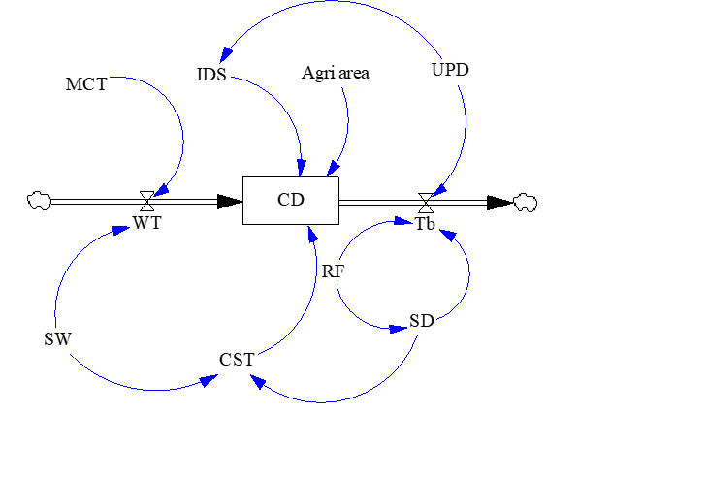
Stock-flow diagram of solid parameter (factor 4)
Multiple Linear Regressions (MLR) equations for upstream pollution sources;
EC = -101.991-(0.578*CST)-(0.074*IDS)(0.194*Tb)+(1.354*WT)+(6.636*Agri area)
IDS = 1219.75-(0.894*UPD)
WT = 10.198+(0.651*MCT) +(0.028*SW)
Tb = -18.183+(19.357*SD)+(0.002*UPD)+(0.235*RF)
CST = SD*SW
Initial variables;
MCT, SW, RF, UPD and AA (agri-area)

Slide 30
System analysis of WQV-SD model (factor 4)
Initial variation
Decreased and slow increase
High increase

Slide 31
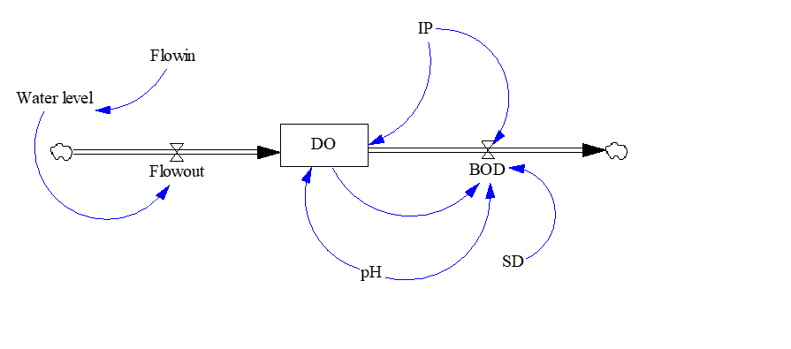
Stock-flow diagram of oxygen parameter (factor 3)
Multiple Linear Regressions (MLR) equations for midstream pollution sources;
DO = 2.739-(0.151*BOD)+(0.065*Flowout)-(0.065*IP)+(0.313*pH)
BOD = 9.904-(0.183*IP)-(0.203*pH)+(0.298*SD)-(1.122*DO)
Flowout = 0.284+(0.097*Water level)
Water level = 21.864+(1.109*Flowin)
Initial variables; Inflow, pH, SD, IP

Slide 32
System analysis of WQV-SD model (factor 3)
Initial variation Increased variation small increased variation

Slide 33
Stock-flow diagram of nutrient parameter (factor 2)
Multiple Linear Regressions (MLR) equations for downstream pollution sources;
NH₃N = 1.315+(-0.039*climatic temperature)+(0.001*water temperature)+(0.5*inflow)
Inflow = (-2.558)+(0.044*rainfall)+(12.407*"NH3-N")
WT = 8.831+(0.607*climatic temperature)-(0.015*inflow)
Initial variable; AA, ABA, RF, MCT

Slide 34
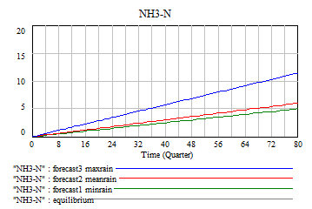
System analysis of WQV-SD model (factor 2)

Slide 35
CONCLUSION
Water quality variations by spatial patterns could presented various periods of water quality by multivariate statistical analysis, moreover, this method could explain group of water quality variation in each part of land use.
Upstream zone should be consideration in area of industry and urbanization, midstream zone should be concentrate in area of economical urbanization and downstream zone should be management in area of agricultural land use as seasonal strategies.
Rainy season, rainfall and level of water are main cause of organic pollutants from land surface to river surface both of rural and urban area. Pollutants and waste controlling in these areas may be could reduce water quality degradation. For example, sufficiently construct waste water treatment plant in urbanization, wastewater discharge controlling from industry and agricultural area restricting.

Slide 36
Multidisciplinary studies in wastes management
BIOMASS FUEL POTENTIAL FROM AGRICULTURAL PRODUCT WASTES IN SOUTHERN BORDER PROVINCES, THAILAND

Slide 37
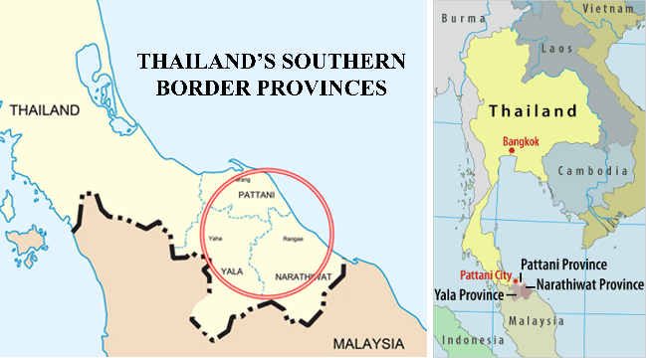

Slide 38


Slide 39
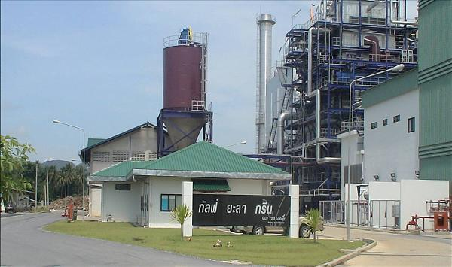

Slide 40
Waste pellets Type | Fixed carbon | Ash | Heating value
Para rubber wood | 14.73±0.52 | 1.40±0.02 | 4,039±64
bagasse | 12.74±0.17 | 0.72±0.04 | 3,618±18
rice husks | 14.50±0.09 | 13.21±0.00 | 3,299±16
bean husks | 14.00±0.25 | 8.13±0.35 | 4,661±92
corn husks with cobs | 15.11±0.55 | 1.74±0.02 | 3,907±12
Agri-waste with durian husks | 16.97±0.48 | 5.02±0.01 | 3,932±108

Slide 41
Conclusion
The Results of a study on the use of agricultural waste to produce biomass briquettes by cold compression method using cassava oil as a binder. It was found that the fuel rods could be extruded well when the mixture ratio by weight of tapioca starch after the measurement of agricultural waste was 100 g: 15 g or more. The resulting fuel had calorific value in the range of 3,299-4,661 kcal/kg. which is sufficient for use as an alternative fuel for biomass power plants and communities Compared to the use of rubber wood fuel used in the area. Which is a biomass fuel that is widely used in power plants in the three southern border provinces today. And the moisture, ash, volatile matter and carbon content were stable in the range similar to that of the green fuels made from other raw materials compared. Which is enough to conclude that In case of wanting to increase the heat value of briquette fuel May consider using waste material or husks from legumes. In case of wanting to reduce humidity Increasing the heating power should consider the waste material from corn and sugar cane. The use of durian peel material will help the fire last longer. But further studies may be needed to reduce the amount of ash feeding.
The comparison of the energy production and environmental benefits of management approaches in this research with agricultural waste measurements for biogas production. It was found that the net energy of 4,685 kcal/kg by using agricultural waste to compress fuel rods was able to reduce greenhouse gas emissions by 15.677 kCO2eq/kg, which was higher than other management approaches.

Slide 42
Multidisciplinary studies in Natural Resources and impact
To study interrelationship of natural resources and agricultural area with land use change, land slide, floods and climatic variation.

Slide 43
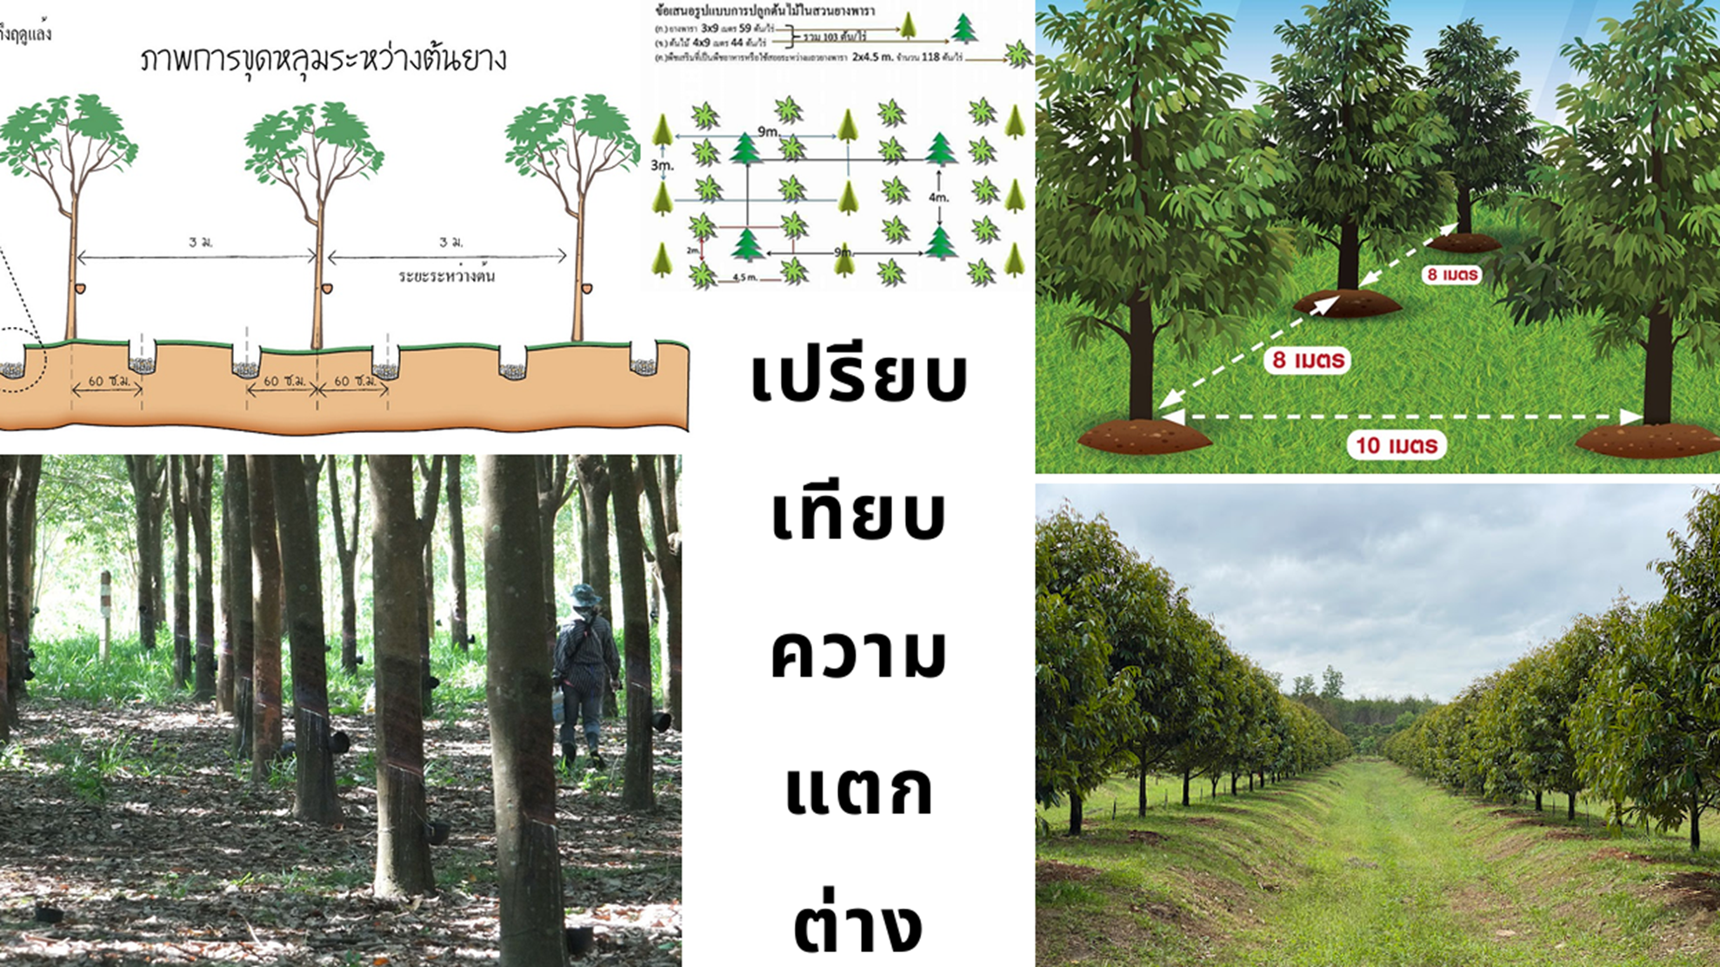
The significant of planting between para-rubber wood and Durian

Slide 44
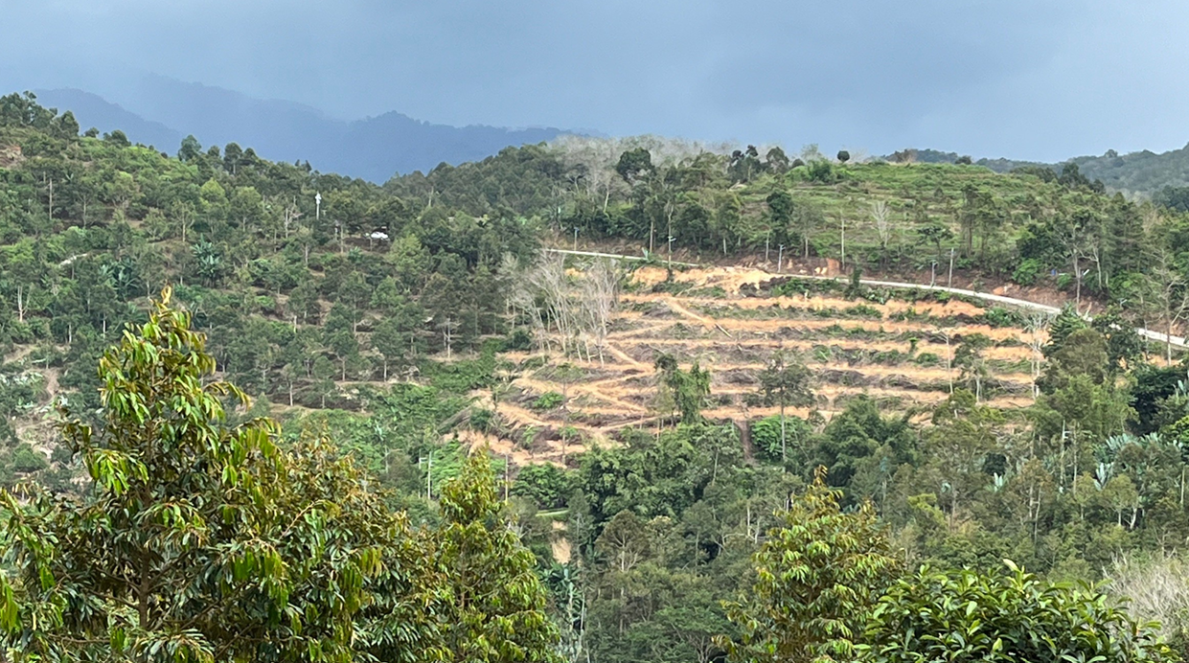

Slide 45
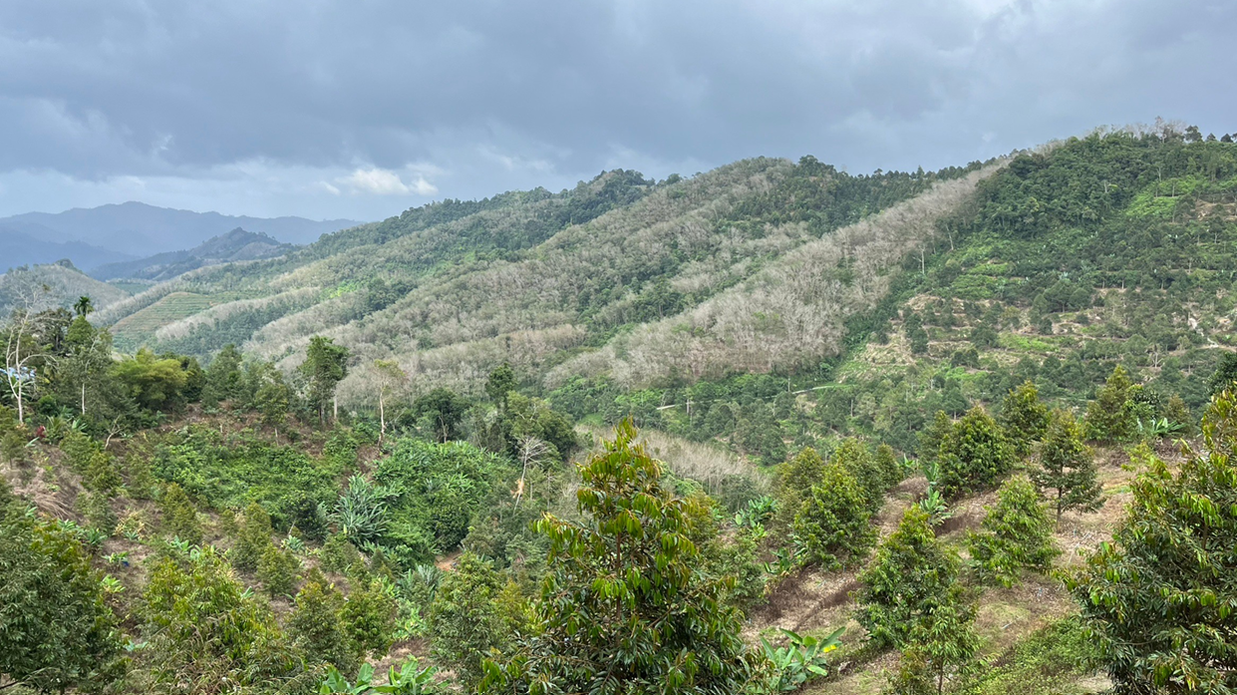

Slide 46
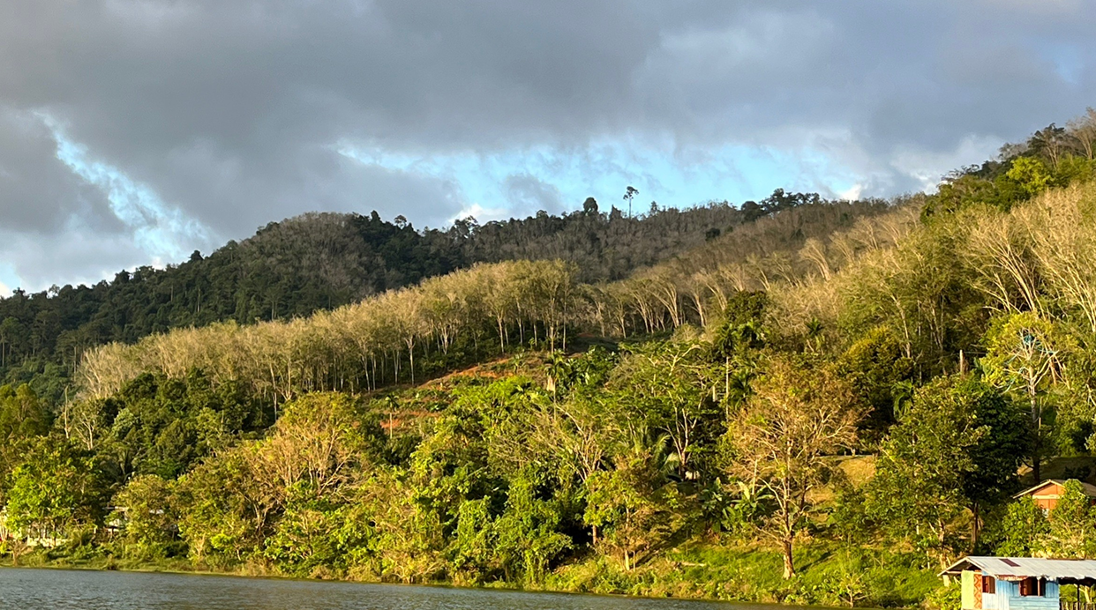

Slide 47
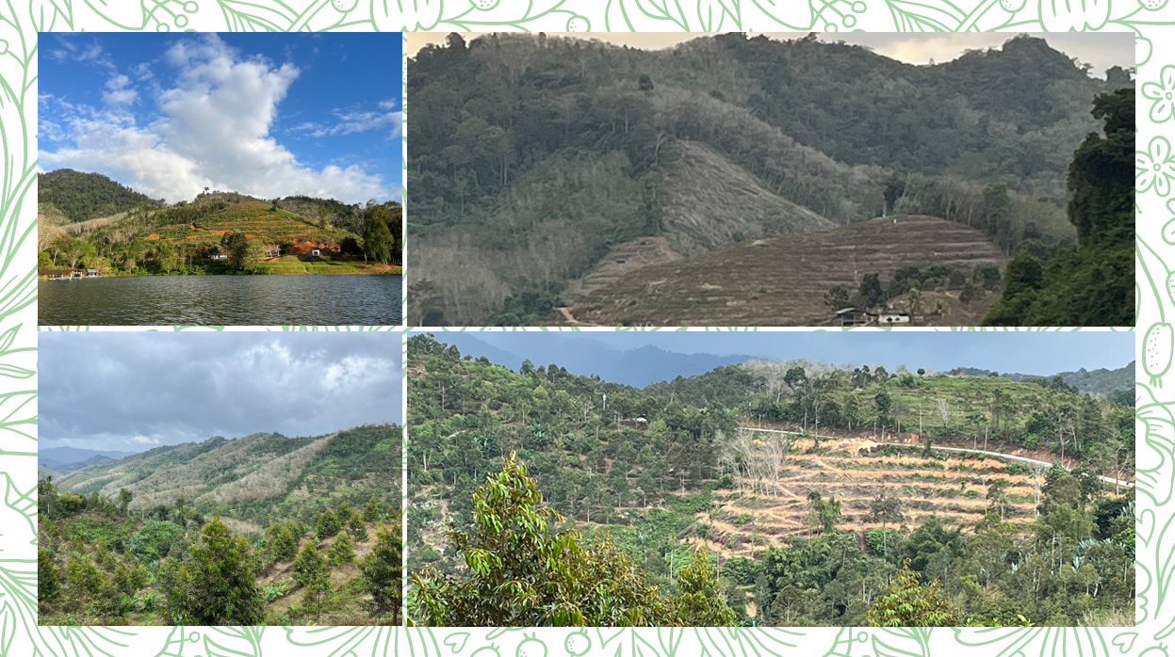

Slide 48
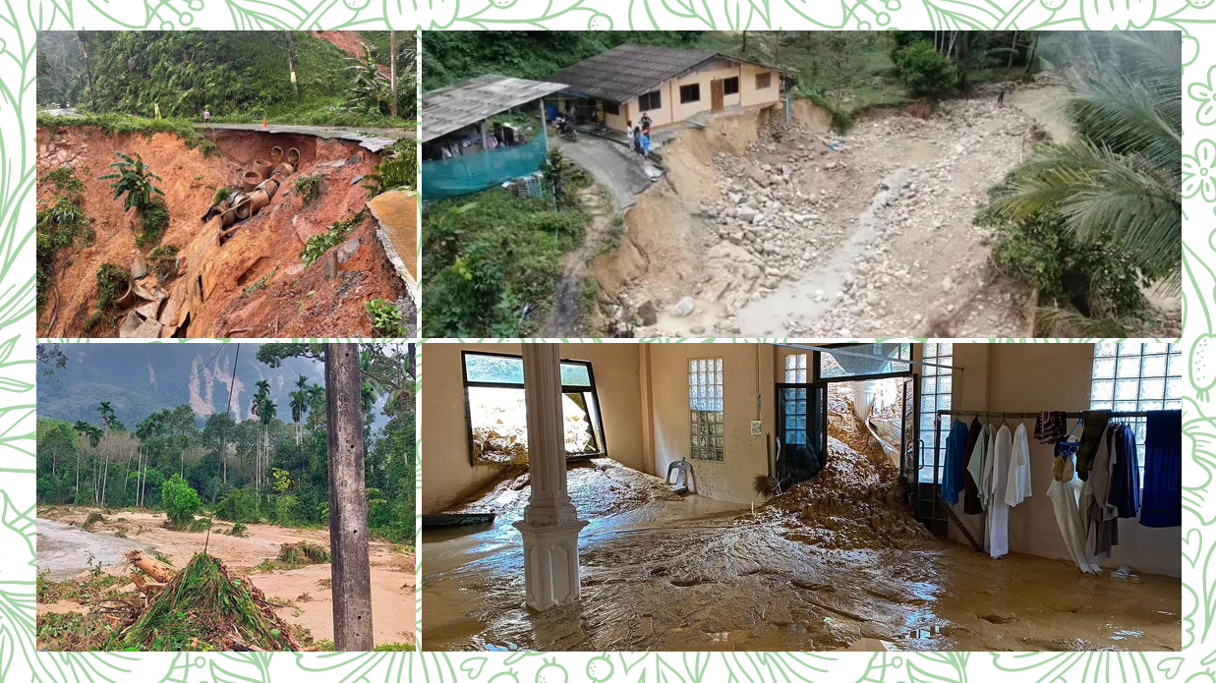

Slide 49
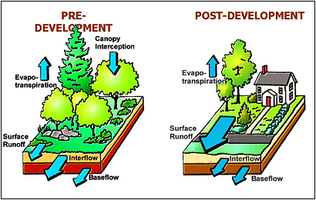
http://www.mde.state.md.us/programs/Water/StormwaterManagementProgram/stormprint/Pages/index.aspx

Slide 50
Conclusion
Floods and Land-slide
Climate change
Hydrology
Human driven force
Land Use

Slide 51
Summary of Multidisciplinary Studies in Environments
Description analysis
(quantitative analysis)
Factor and cluster analysis (qualitative data)
Correlation and regression analysis
Discussion
Causal-feedback loop and stock flow diagram
Assessment
Factors
Land use pattern and practice
Human driven force
variables
Urbanization/agriculture/ industry
Model
Multiple linear-nonlinear regression equation
Scenarios
Climatic and hydrologic change 5, 10, 20 years
management
Public policy
Environment issues
Public policy/public participate/ad. regulation
Environment components
Low/moderate/high risks
Spatial / temporal
Hydrology
Climate change
Statistics parameters
System dynamic model
Public par
regulation
❸
Scenarios display and Discussion (Arc-GIS ®)
❶
Parametric study: multivariate analysis
(SPSS ®)
❷
Dynamic Modeling
(VENSIM Ple-Plus Academic ®)

Slide 52
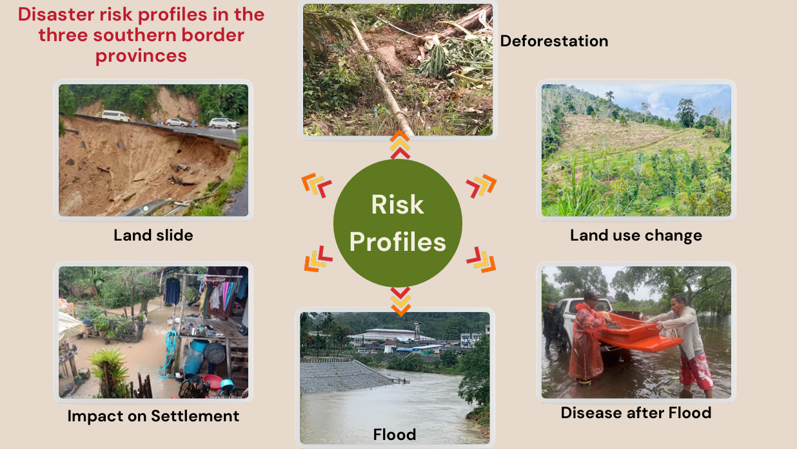
Thank you for your attention

